Slide 1


Zomato Portfolio
Project
Get Started

Slide 2

About Us Zomato
Delivery
Zomato is an online food delivery platform offering a loyalty program called Zomato Gold with exclusive discounts. This SQL project analyzes customer behavior, purchase patterns, and Zomato Gold's effectiveness using a fictional dataset.

Slide 3
Dataset Description
The project utilizes the following tables:
goldusers_signup: Contains data about users who have signed up for the Zomato Gold membership, along with their signup dates.
users: Contains data about all users on the platform, including their signup dates.
sales: Contains data about sales transactions, including the user who made the purchase, the date of purchase, and the product purchased.
product: Contains data about the products available on Zomato, including product IDs, product names, and prices.

Slide 4
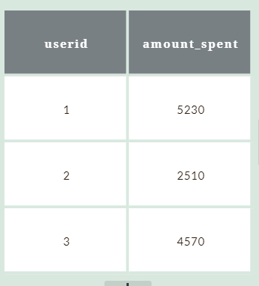
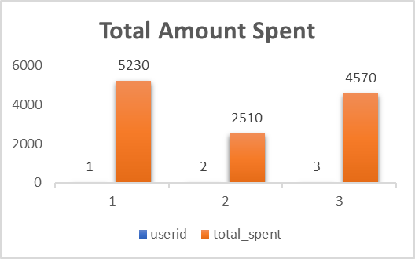
Customer Wise
Spent
Express Courier
03
Ware House
Nam ultricies dui vulputate, ornare dui pulvinar, pretium eros.
Nam ultricies dui vulputate, ornare dui pulvinar, pretium eros.

Slide 5
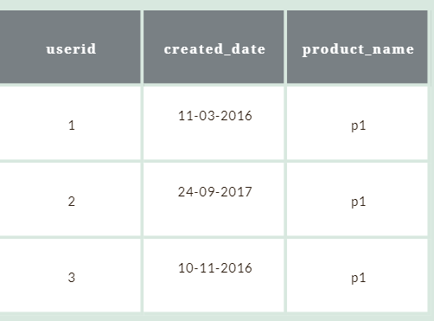
First Product Purchased
by each Customer
P1 Product is purchased first
and through this we analyse
that P1 is the most prominent sku
Express Courier
03
Ware House
Nam ultricies dui vulputate, ornare dui pulvinar, pretium eros.
Nam ultricies dui vulputate, ornare dui pulvinar, pretium eros.

Slide 6
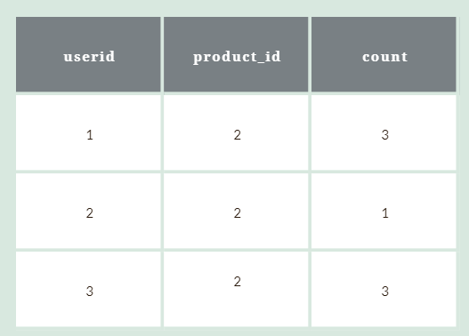
Most Purchased Item
and Count
From table we know that userid:1,3
our gold memebers and there might
be they would be getting extra benefit from product id 2
Express Courier
03
Ware House
Nam ultricies dui vulputate, ornare dui pulvinar, pretium eros.
Nam ultricies dui vulputate, ornare dui pulvinar, pretium eros.

Slide 7
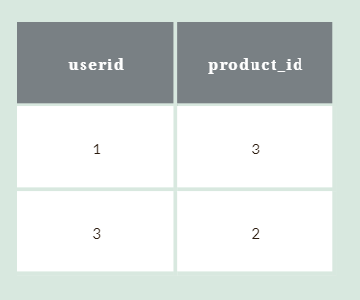
First Product Purchased
after being member
A targeted promotion likely encouraged users to buy that product before signing up for Zomato Gold.
Express Courier
03
Ware House
Nam ultricies dui vulputate, ornare dui pulvinar, pretium eros.
Nam ultricies dui vulputate, ornare dui pulvinar, pretium eros.

Slide 8
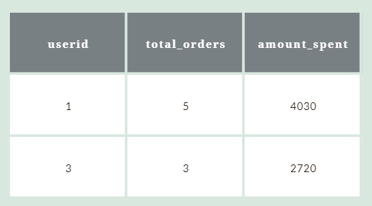
Total Orders and Amount
Spent before membership
Userid :1 A regular customer
since order count and amount
spent is much higher
So order and amount can be a
metric to calculate the no of customer
turning in gold member
03
Ware House
Nam ultricies dui vulputate, ornare dui pulvinar, pretium eros.
Nam ultricies dui vulputate, ornare dui pulvinar, pretium eros.
Express Courier

Slide 9

About Zomato
Points
Zomato's point system rewards customers based on their purchases. Points are earned differently for each product:
p1: 1 point for every ₹5 spent.
p2: 5 points for every ₹10 spent.
p3: 1 point for every ₹5 spent.
This system incentivizes spending by offering varying points for different products.

Slide 10
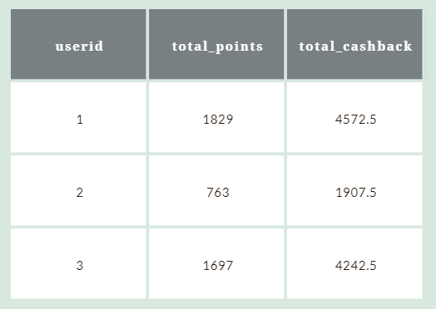
Total Points Earned and
Cashback
Express Courier
03
Ware House
Nam ultricies dui vulputate, ornare dui pulvinar, pretium eros.
Nam ultricies dui vulputate, ornare dui pulvinar, pretium eros.

Slide 11
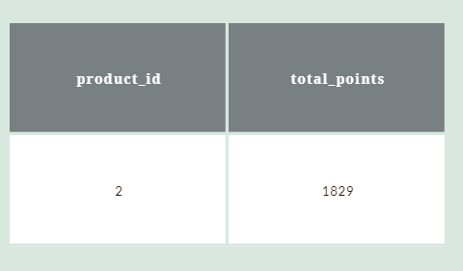
Most Points given
for a Product
P2 Product yields most
number of Zomato points
Express Courier
03
Ware House
Nam ultricies dui vulputate, ornare dui pulvinar, pretium eros.
Nam ultricies dui vulputate, ornare dui pulvinar, pretium eros.

Slide 12
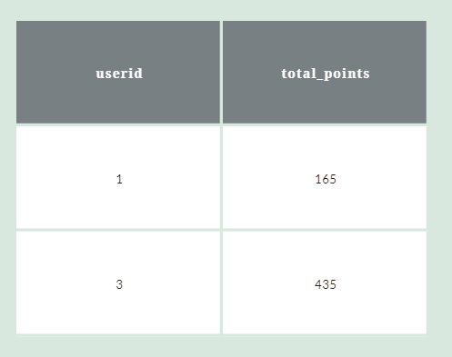
No of Points Earned in 1yr
of Membership
User3 has earned far more points than
that off user1 and to retain gold memeber ,
User1 must be provided with custom offers.
03
Ware House
Nam ultricies dui vulputate, ornare dui pulvinar, pretium eros.
NOTE : Earn 5 zomato points for every 10rs spent

Slide 13
Key Insights from
Analysis
Since P1 is most first purchase my any customer, so its the main sku and should always be in stock to gain more customers.
User:2 must be given special offer and deals to convert it him in GOLD MEMBER of Zomato
target Marketing must be approached for more better results ahead in Zomato

Slide 14
For any suggestions
Email : mailboxabhi2802@gmail.com
Github :
Get Started

Slide 15
Thank You

